Slide 1
Microprocessors, Microcontrollers & Embedded systems
8051 Interrupts and Timers

Slide 2
8051 Interrupts
An event (external/internal) that interrupts the controller to inform that a device needs its service
Interrupts "put on hold" the normal program flow, execute a dedicated piece of code (interrupt handler or ISR), and resume normal program flow as if we had never left it
Interrupts are convenient & efficient than to manually check for status of the event (polling)
Events can be one of
Timers 0 or 1 overflowing
Receive or transmit a character via serial port
One of the two external events
Reset
Complete execution of instruction
void main()
{
while(1)
{
Line 1
Line 2
Line 3
Line 4
Line 5
….
….
….
Line N
}
}
Push the PC; Save interrupt status
Interrupt
Jump to ISR and continue execution
ISR
ISR
ISR
Upon RETI, pop PC from stack
Main
Main
Main
Main
Time

Slide 3
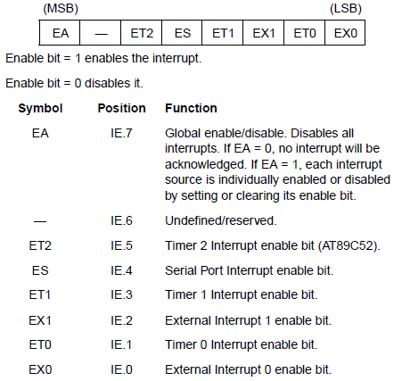
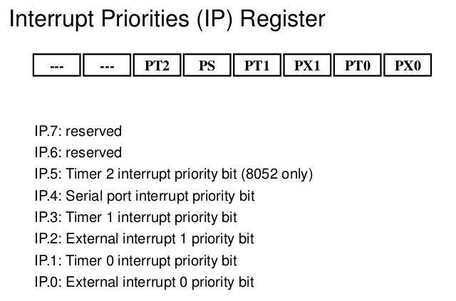
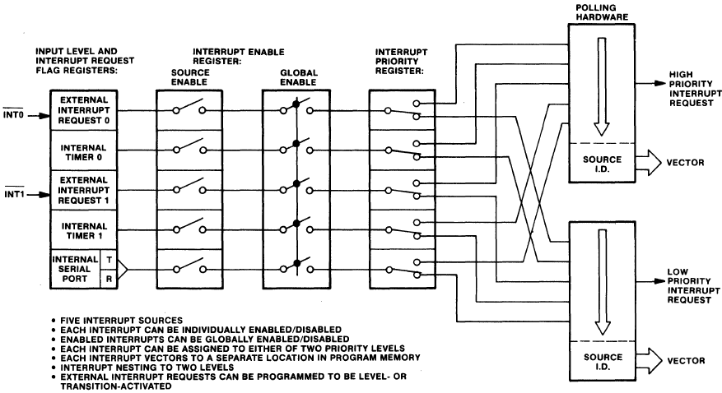
8051 Interrupts
Interrupt Enable (IE) Register
Interrupt Priority (IP) Register
All interrupts are disabled after reset
While processing ISR, interrupt is automatically cleared, except RI/TI
IE register allows enabling/disabling Interrupts
IP register permits altering priority
Interrupt | Priority (0:Highest 5: Lowest) | ISR address | Remarks
External Interrupt 0 | 1 | 0x0003 | Only 8 memory locations between ISRs? What can you code in it?
Timer 0 Overflow | 2 | 0x000B
External Interrupt 1 | 3 | 0x0013
Timer 1 Overflow | 4 | 0x001B
Serial Port | 5 | 0x0023
Timer 2 Overflow (8052+) |  | 0x002B
Reset | 0 | ?
https://www.slideserve.com/osbourne/interrupt
https://www.slideshare.net/daniemol/8-interrupt-8051

Slide 4
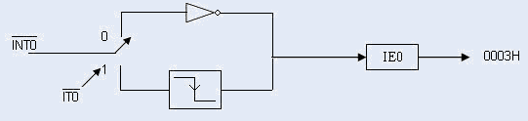
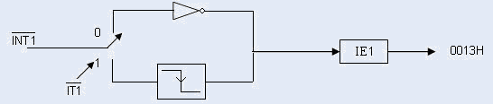

8051 External Interrupts
TCON used to define external interrupt
Can be (falling) edge triggered or (low) level-triggered
IE & IP registers enable and prioritizes external interrupts
TCON
Bit Mnemonic | Description
IE1/0 | Interrupt 1/0 Edge Flag: Cleared by hardware when interrupt is processed if edge-triggered. Set by hardware when external interrupt is detected on INT1#/INT0# pin.
IT1/0 | Interrupt 1/0 Type Control Bit: Clear to select low level active (level triggered) for external interrupt 1/0 (INT1#/INT0#). Set to select falling edge active (edge triggered) for external interrupt 1/0.

Slide 5
8051 Timers
Two 16-bit timers/counters
Timers to generate a time delay
Event counters to count external events
Since 8051 is an 8-bit microcontroller, each 16-bit timer register is accessed as two separate registers TLx and THx
TMOD from SFR is used to set various timer operation modes
TCON
Bit Mnemonic | Description
TF1/0 | Timer 1/0 Overflow Flag: Cleared by hardware when processor vectors to interrupt routine. Set by hardware on timer/counter overflow, when the timer 1/0 register overflows.
TR1/0 | Timer 1/0 Run Control Bit: Clear to turn off timer/counter 1/0. Set to turn on timer/counter 1/0.
IE1/0 | Interrupt 1/0 Edge Flag: Cleared by hardware when interrupt is processed if edge-triggered. Set by hardware when external interrupt is detected on INT1#/INT0# pin.
IT1/0 | Interrupt 1/0 Type Control Bit: Clear to select low level active (level triggered) for external interrupt 1/0 (INT1#/INT0#). Set to select falling edge active (edge triggered) for external interrupt 1/0.

Slide 6
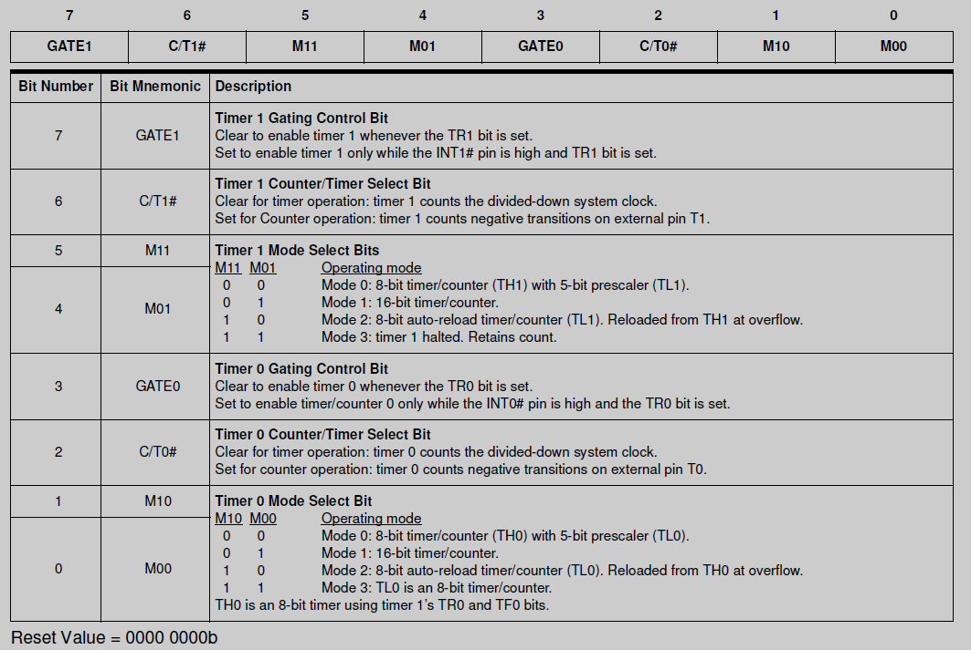
8051 Timers
TMOD from SFR is used to set various timer operation modes
TMOD

Slide 7
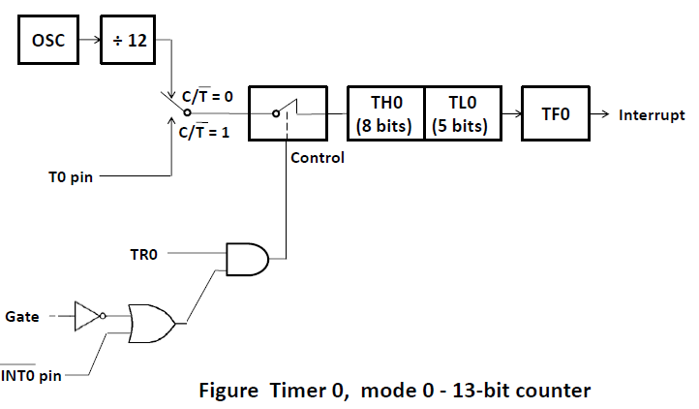
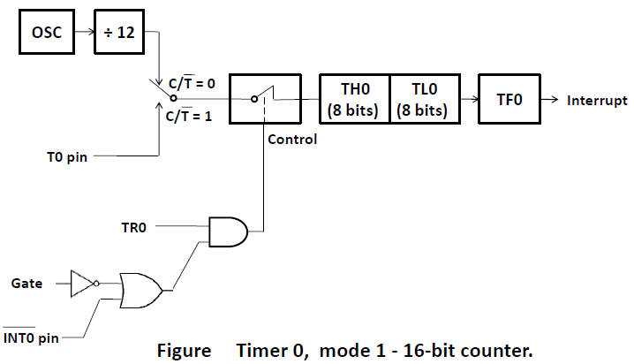
8051 Timer modes
Mode 0: 13-bit counter
Mode 1: 16-bit counter

Slide 8
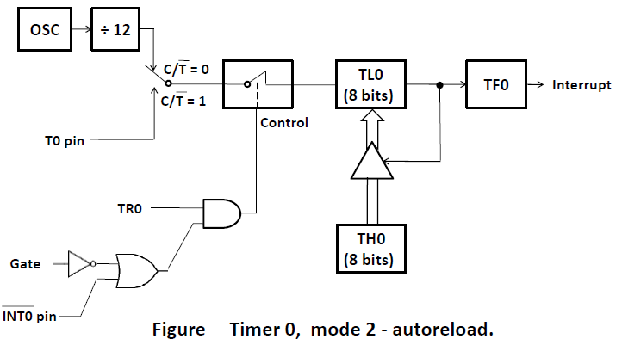
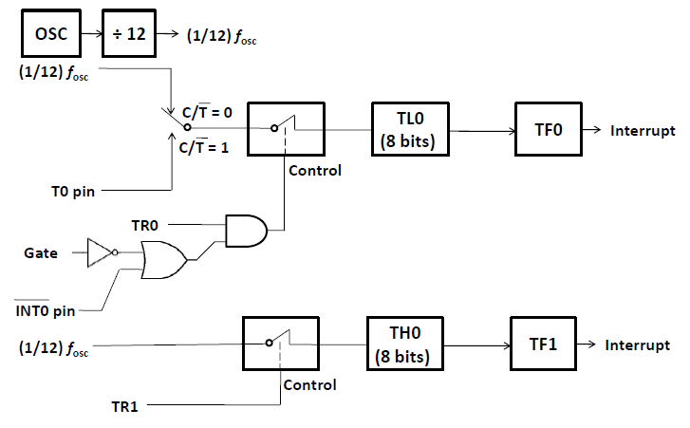
8051 Timer modes
Mode 2: 8-bit counter with auto reload
Mode 3: Split operation Timer 0
Timer 1 is disabled

Slide 9
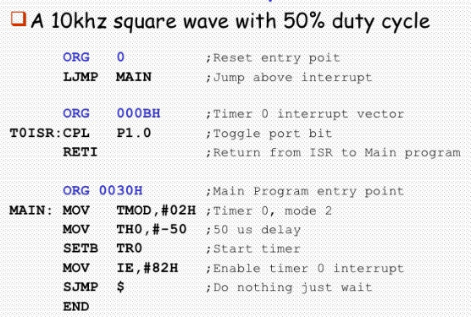
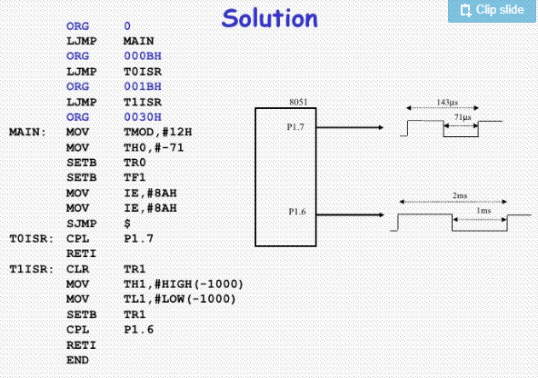
8051 Interrupts: Example
All interrupts are disabled after reset
While processing ISR, interrupt is automatically cleared, except RI/TI
IE register allows enabling/disabling Interrupts
IP register permits altering priority
Interrupt Enable (IE) Register
Interrupt Priority (IP) Register
TMOD
Example 1:
Example 2: Program to use interrupts to create 7kHz and 500Hz square waves on P1.7 and P1.6
https://www.slideshare.net/daniemol/8-interrupt-8051

